Slide 2
Learning Objectives
LO 6.1 Define weathering and distinguish between the two main categories of weathering.
LO 6.2 List and describe four examples of mechanical weathering.
LO 6.3 Discuss the importance of water and carbonic acid in chemical weathering processes.
LO 6.4 Summarize the factors that influence the type and rate of rock weathering.

Slide 3
Learning Objectives (cont.)
LO 6.5 Define soil and explain why soil is referred to as an interface. List and briefly discuss five controls of soil formation.
LO 6.6 Sketch, label, and describe an idealized soil profile. Explain the need for classifying soils.
LO 6.7 Explain the detrimental impact of human activities on soil.
LO 6.8 Relate weathering to the formation of certain ore deposits.

Slide 4
6.1 Weathering
Weathering: The physical breakdown and chemical alteration of rock at or near Earth’s surface
Mechanical weathering: Physical forces that break rock into smaller pieces without changing composition
Chemical weathering: Chemical transformation into new compounds

Slide 5
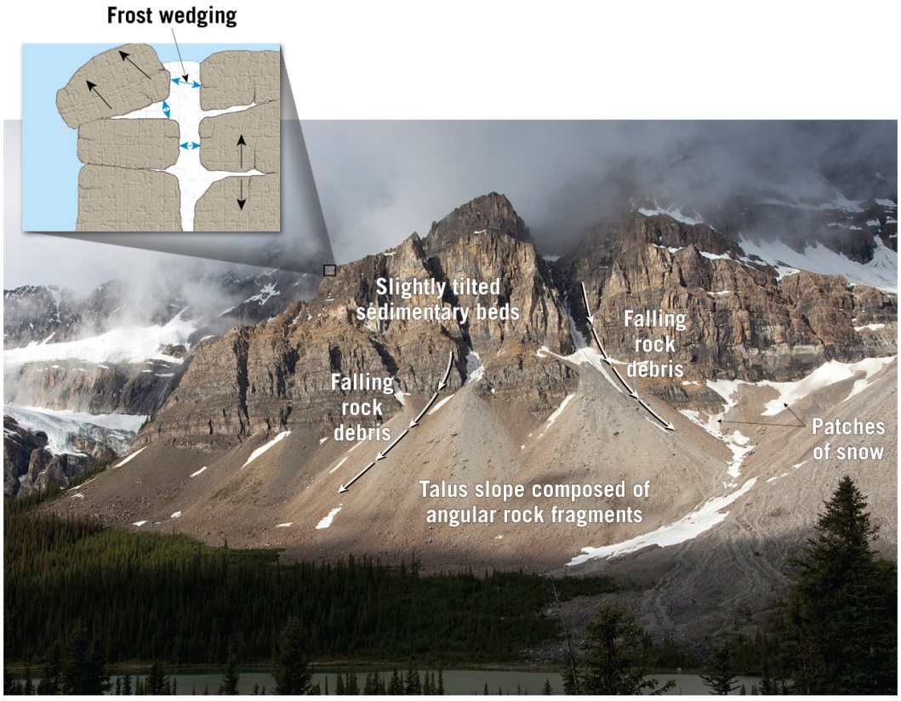
6.2 Mechanical Weathering
Types of mechanical weathering
Frost wedging: Alternate freezing and thawing of water in fractures and cracks promotes the disintegration of rocks.
Tutorial

Slide 6
6.2 Mechanical Weathering (cont.)
Mechanical weathering (continued)
Sheeting: Exfoliation of igneous and metamorphic rocks at the Earth’s surface as a result of a reduction in confining pressure
Salt crystal growth
Sea spray or salty groundwater penetrates crevices and pore spaces in rocks
As the water evaporates, salt crystals form and enlarge the crevices
Biological activity: Disintegration resulting from plants and animals

Slide 7
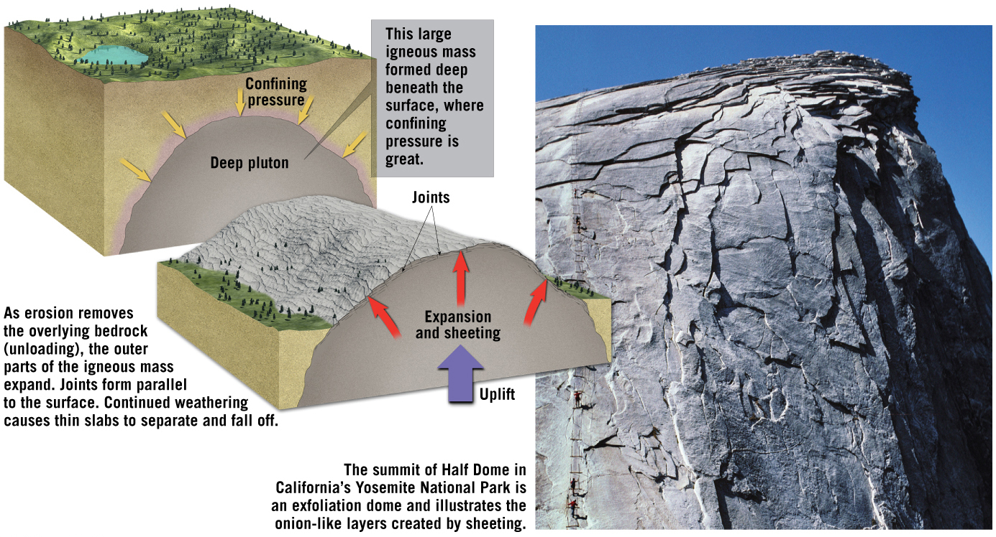
Exfoliation of Igneous Rocks
Tutorial

Slide 8
6.3 Chemical Weathering
Chemical weathering
Breaks down rock components and the internal structures of minerals
Most important agent involved in chemical weathering is water (responsible for transport of ions and molecules involved in chemical processes)

Slide 9
6.3 Chemical Weathering (cont.)
Major processes of chemical weathering
Carbonic Acid
Carbon dioxide is dissolved in water and creates carbonic acid
Dissolves carbonate rocks
Oxidation
Any chemical reaction in which a compound or radical loses electrons
Important in decomposing ferromagnesian minerals

Slide 10
6.3 Chemical Weathering (cont.)
Major processes of chemical weathering
How granite weathers
Chemically attacked by carbonic acid
Hydrogen ion attacks and replaces other positive ions, like potassium
Most abundant product is clay minerals

Slide 11
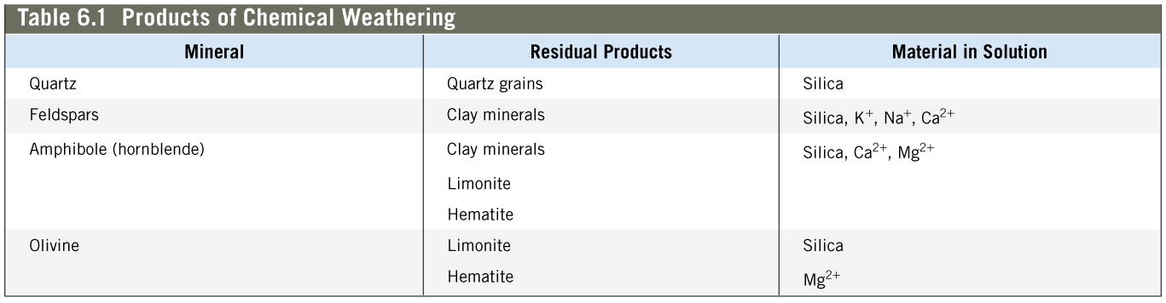
Products of Chemical Weathering

Slide 12
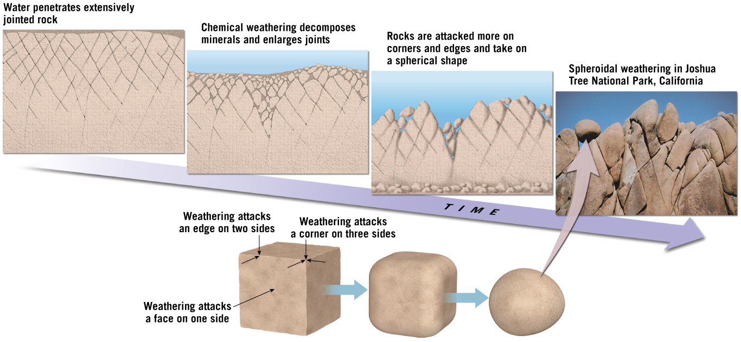
6.3 Chemical Weathering
Alterations caused by chemical weathering
Decomposition of unstable minerals
Generation or retention of materials that are stable
Physical changes such as the rounding of corners or edges (spheroidal weathering)
Tutorial

Slide 13
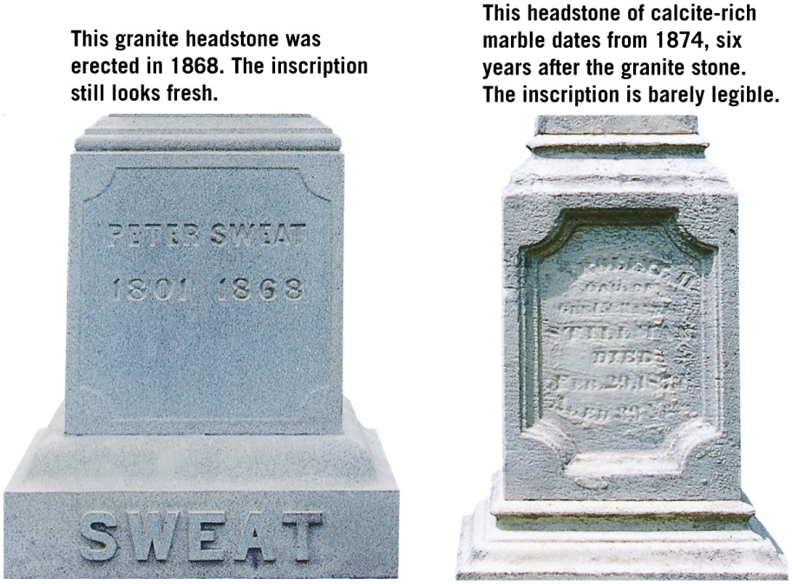
6.4 Rates of Weathering
Factors affecting weathering
Rock characteristics
Rocks containing calcite (marble and limestone) readily dissolve in weakly acidic solutions.
Silicate minerals weather in the same order as their order of crystallization.
Tutorial

Slide 14
6.4 Rates of Weathering (cont.)
Others factors affecting weathering
Climate
Temperature and moisture are the most crucial factors.
Chemical weathering is most effective in areas of warm, moist climates.
Differential weathering
Masses of rock do not weather uniformly because of regional and local factors.
Results in many unusual and spectacular rock formations and landforms.

Slide 15
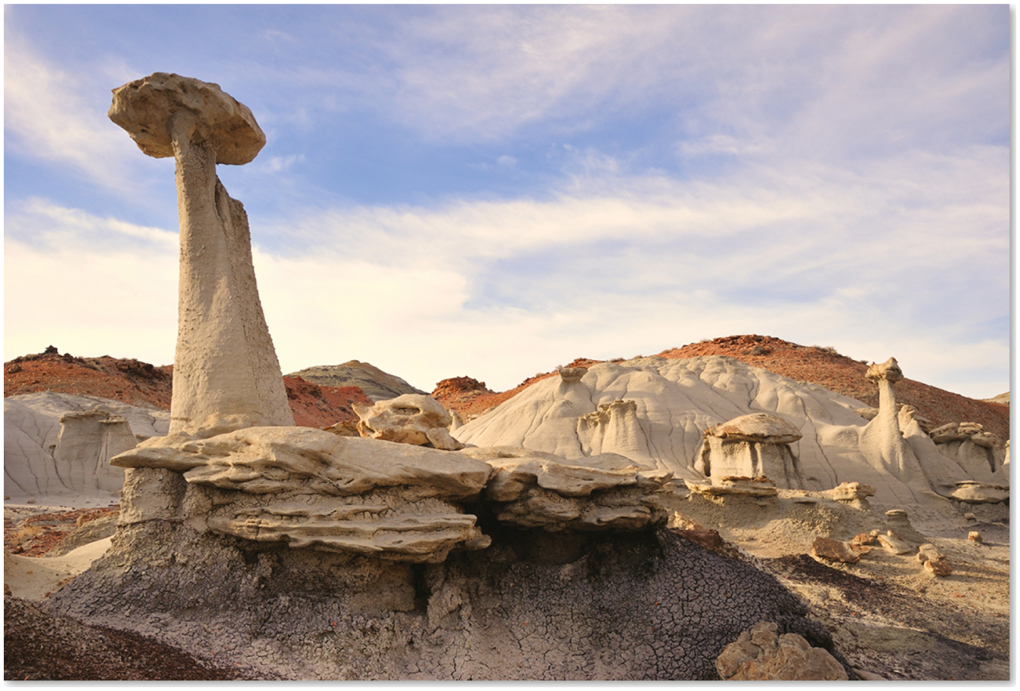
Differential Weathering
Mobile Field Trip

Slide 16
6.5 Soil: An Indispensable Resource
Soil is a combination of mineral and organic matter, water, and air.
That portion of the regolith (rock and mineral fragments produced by weathering) that supports the growth of plants.

Slide 17
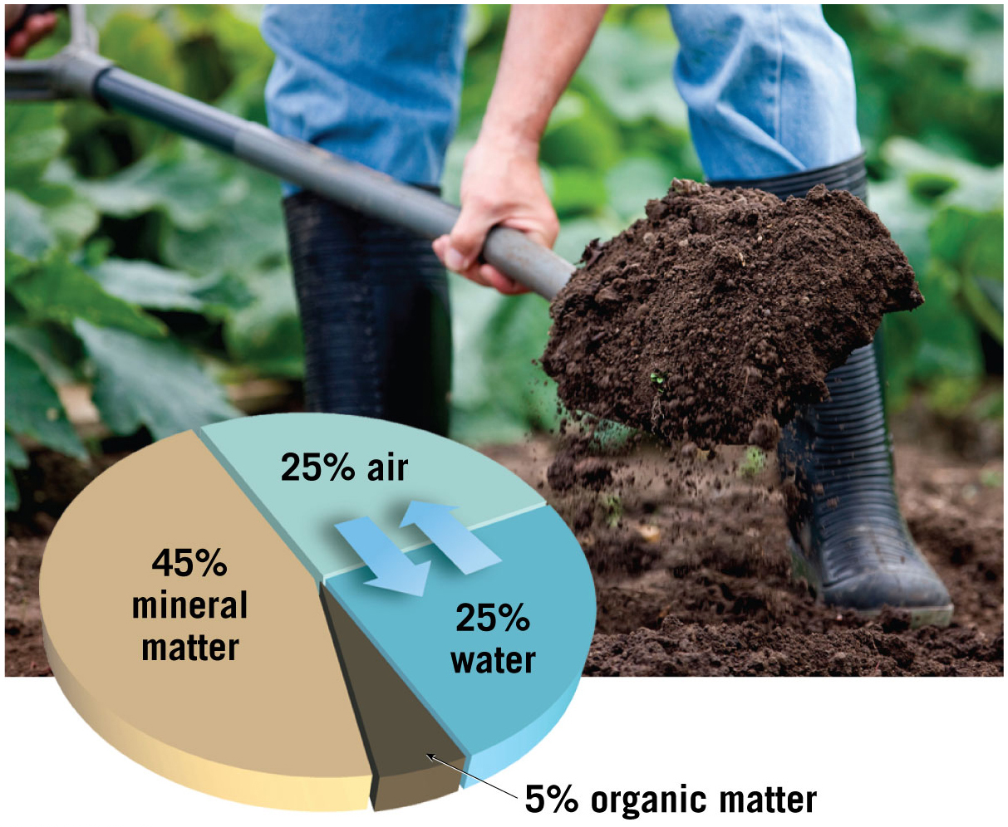
Typical Components in a Soil That Yield Good Plant Growth

Slide 18
6.5 Soil: An Indispensable Resource
Factors controlling soil formation
Parent material
Residual soil: Parent material is the underlying bedrock
Transported soil: Forms in place on parent material that has been carried from elsewhere and deposited

Slide 19
6.5 Soil: An Indispensable Resource (cont.)
Factors controlling soil formation
Time
Important in all geologic processes
Amount of time for soil formation varies for different soils depending on geologic and climatic conditions
Climate
Most influential control of soil formation
Key factors are temperature and precipitation

Slide 20
6.5 Soil: An Indispensable Resource (cont.)
Factors controlling soil formation
Plants and animals
Organisms influence the soil’s physical and chemical properties
Also furnish organic matter to the soil
Topography
Steep slopes often have poorly developed soils
Optimum terrain is a flat-to-undulating upland surface

Slide 21
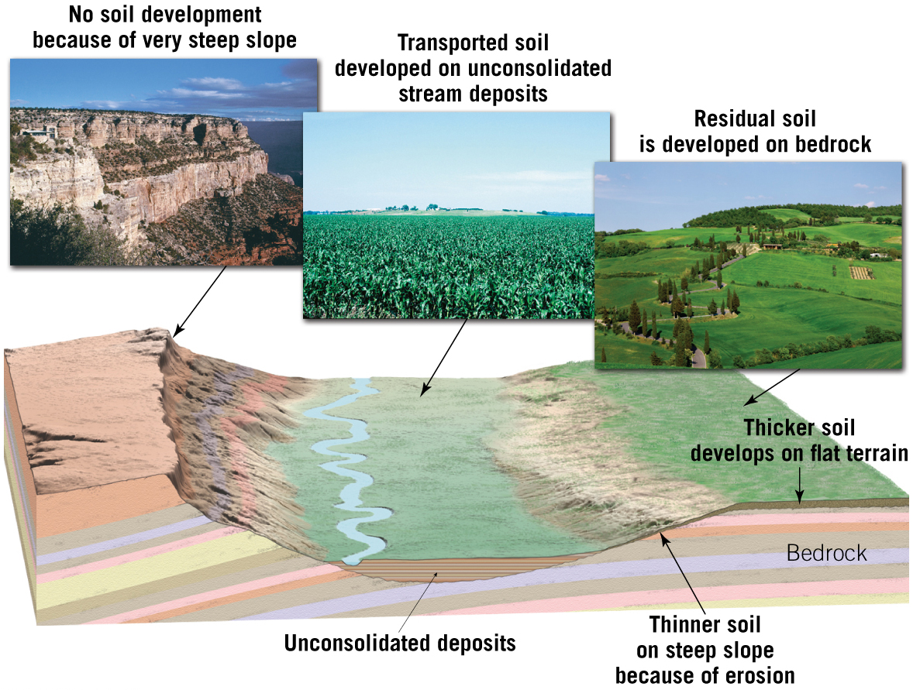
Soil Development

Slide 22
6.6 Describing & Classifying Soils
The soil profile
Soil forming processes operate from the surface downward.
Vertical differences are called horizons, which are zones or layers of soil.

Slide 23
6.6 Describing & Classifying Soils (cont.)
The soil profile
O horizon: Organic matter
A horizon: Organic and mineral matter
High biological activity
Together the O and A horizons make up the topsoil
E horizon: Little organic matter
Zone of eluviation and leaching

Slide 24
6.6 Describing & Classifying Soils (cont.)
The soil profile
B horizon: Zone of accumulation
C horizon: Partially altered parent material
The O, A, E, and B horizons together are called the solum, or “true soil.”

Slide 25
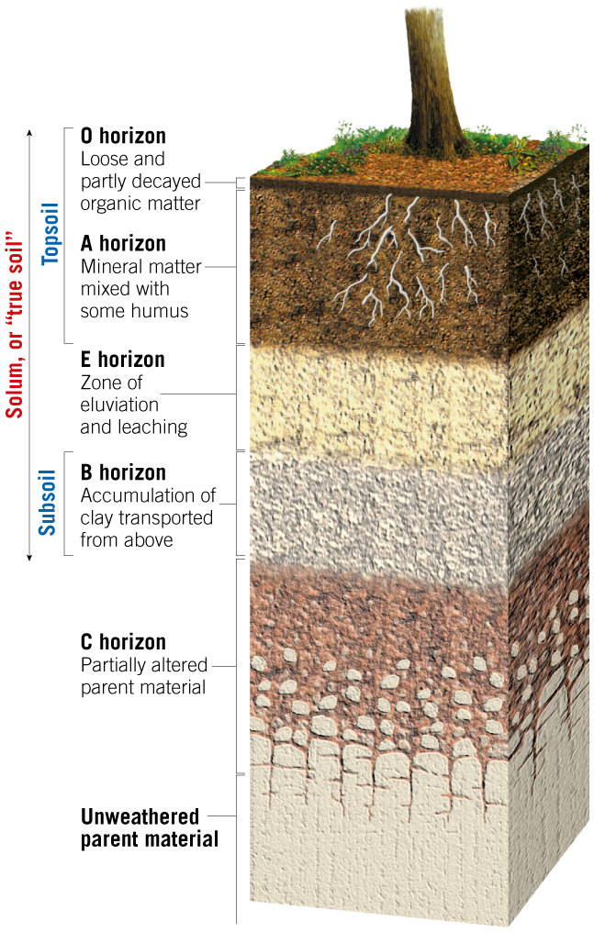
An Idealized Soil Profile
Tutorial

Slide 26
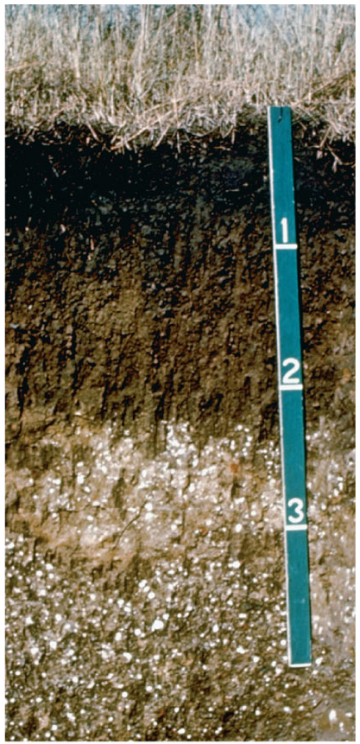
A Soil Profile Showing Different Horizons

Slide 27
6.6 Describing & Classifying Soils
Soil types
Groups consist of items that have certain important characteristics in common
Soils are classified using a system known as the soil taxonomy.
Based on physical and chemical properties of the soil profile

Slide 28
6.6 Describing & Classifying Soils (cont.)
Soil taxonomy
Includes six hierarchical categories of classification, ranging from order (broadest) to series (most specific)
Especially useful for agricultural and related land-use purposes

Slide 29
6.7 The Impact of Human Activities on Soil
The agricultural productivity of soils can be improved through fertilization and irrigation.
Soils can be damaged or destroyed by careless activities.
Soils are crucial for providing food, fiber, and other basic materials.
Soils are one of the most abused resources.

Slide 30
6.7 The Impact of Human Activities on Soil (cont.)
Clearing the tropical rain forest: A Case Study
Tropical forests are cleared for logging and agricultural use.
Soils in tropical forests are poor in nutrients and unsuitable for agriculture.
Most of the nutrients in tropical rain forests are found in the trees.
Clearing tropical rain forests also promotes soil erosion.

Slide 31
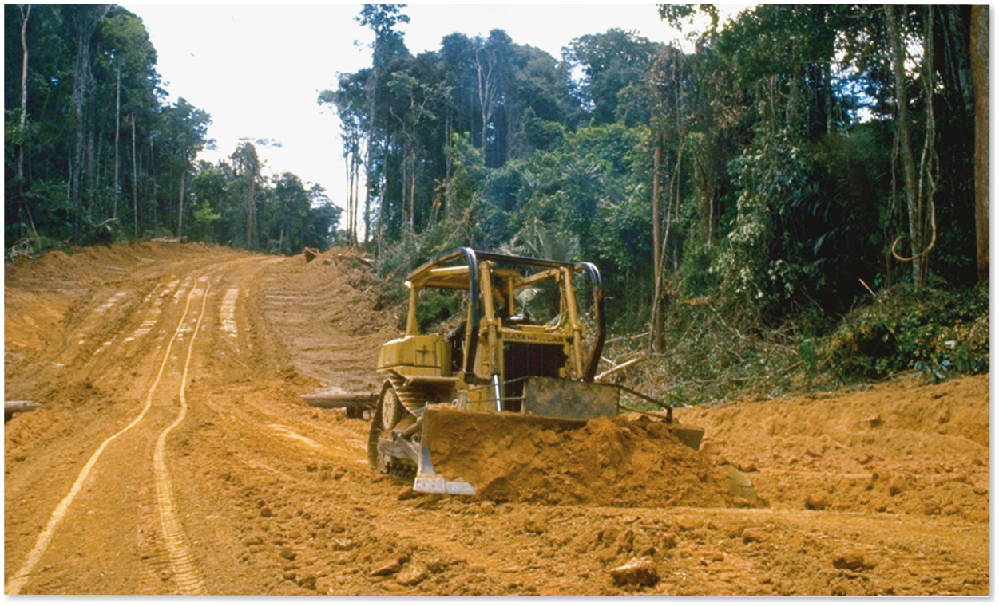
Tropical Deforestation

Slide 32
6.7 The Impact of Human Activities on Soil
Soil erosion
Soil erosion is a natural process in the rock cycle.
Erosion rates are dependent on climate, slope, and type of vegetation.
Human activities such as deforestation and farming practices can enhance soil erosion.

Slide 33
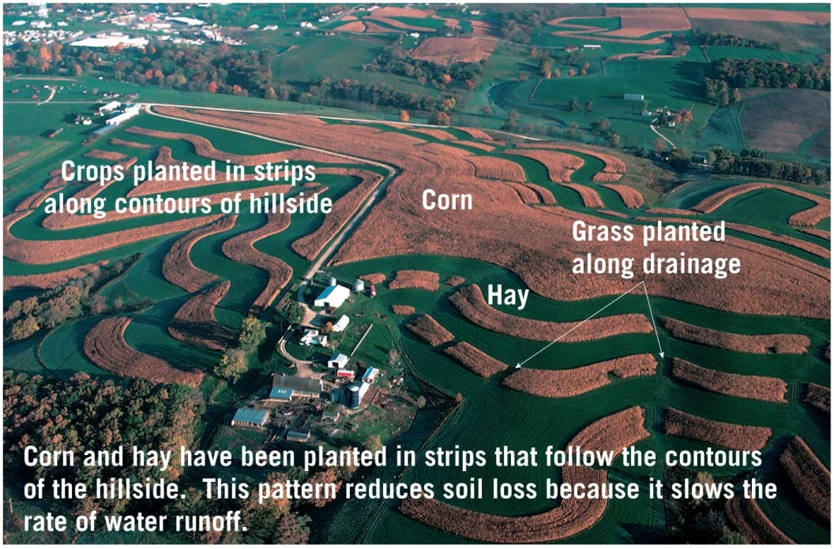
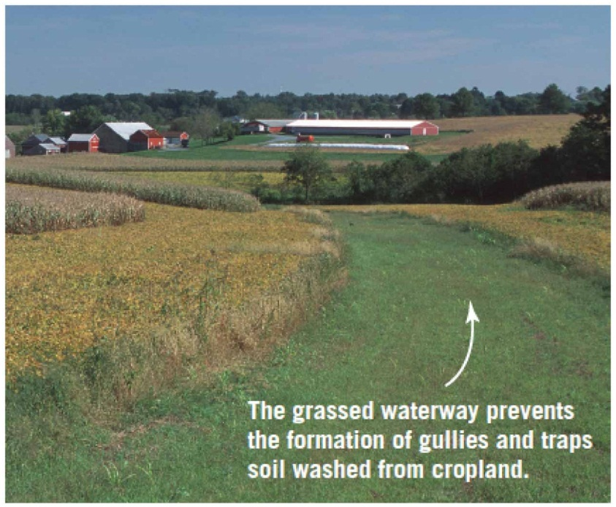
Examples of Soil Conservation

Slide 34
6.8 Weathering & Ore Deposits
Weathering creates deposits by concentrating metals into economically valuable concentrations (secondary enrichment).
Bauxite
Principal ore of aluminum
Forms in rainy tropical climates from chemical weathering and the removal of undesirable elements by leaching

Slide 35
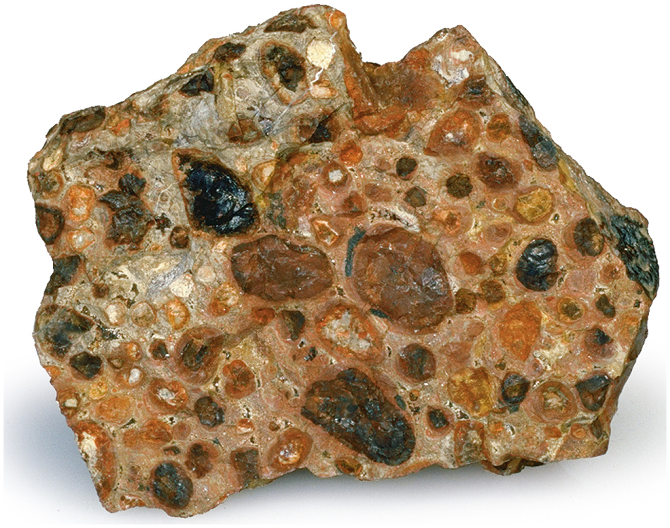
Bauxite

Slide 36
6.8 Weathering & Ore Deposits
Other deposits
Weathering processes concentrate metals that are deposited through low-grade primary ore.
Examples: Copper and Silver
Typically occurs in deposits containing pyrite

